Slide 1

HPCViz: Visualizing and Monitoring Health Status of High Performance Computing Systems
Tommy Dang, Vinh Nguyen, Vung Pham,
Ghazanfar Ali, Yong Chen October 11, 2018

Slide 2

AGENDA
Introduction
Problem statement
Research Focus
HPCViz architecture
Demo
Conclusion

Slide 3
Introduction
https://www.marketsandmarkets.com/PressReleases/Quantum-High-Performance-Computing.asp

Slide 4
Introduction
Reliable storage
Enhanced scalability
Efficient computing
Handle large
volume of data
Accelerate analysis

Slide 5
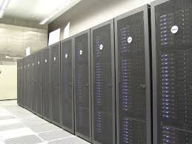



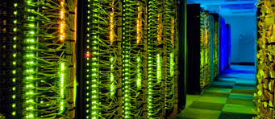
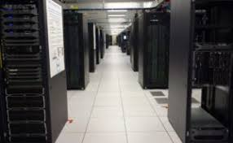
Introduction
HPCC – Texas Tech Uni.
Hewlett Packard Enterprise
IBM.com
Intel.com
HPC - Southern California
Dell EMC

Slide 6
Introduction
Meeting of monitoring experts from nine large supercomputing centers reported some challenges:
hierarchical data management
better power monitoring and control
standard interfaces for monitoring
Allcock, William, et al. "Challenges of HPC monitoring." High Performance Computing, Networking, Storage and Analysis (SC), 2011 International Conference for. IEEE, 2011.

Slide 7
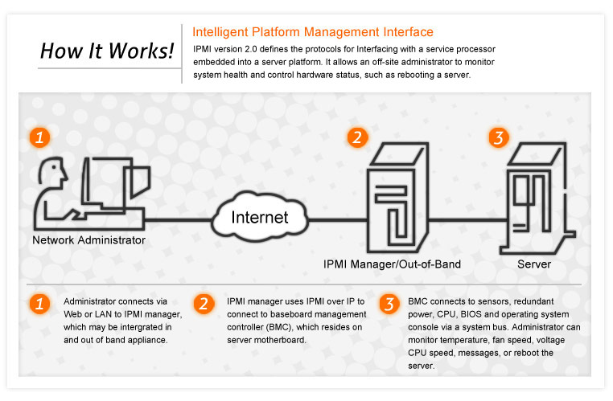

Existing approach and problem statement

Slide 8
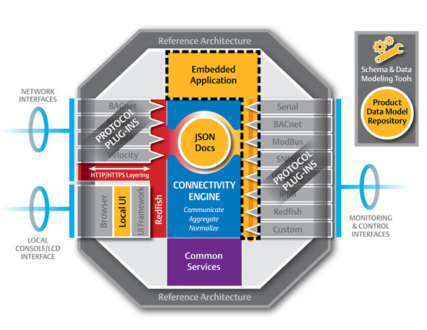

Existing approach and problem statement
https://datacenterfrontier.com/redfish-specifications/

Slide 9
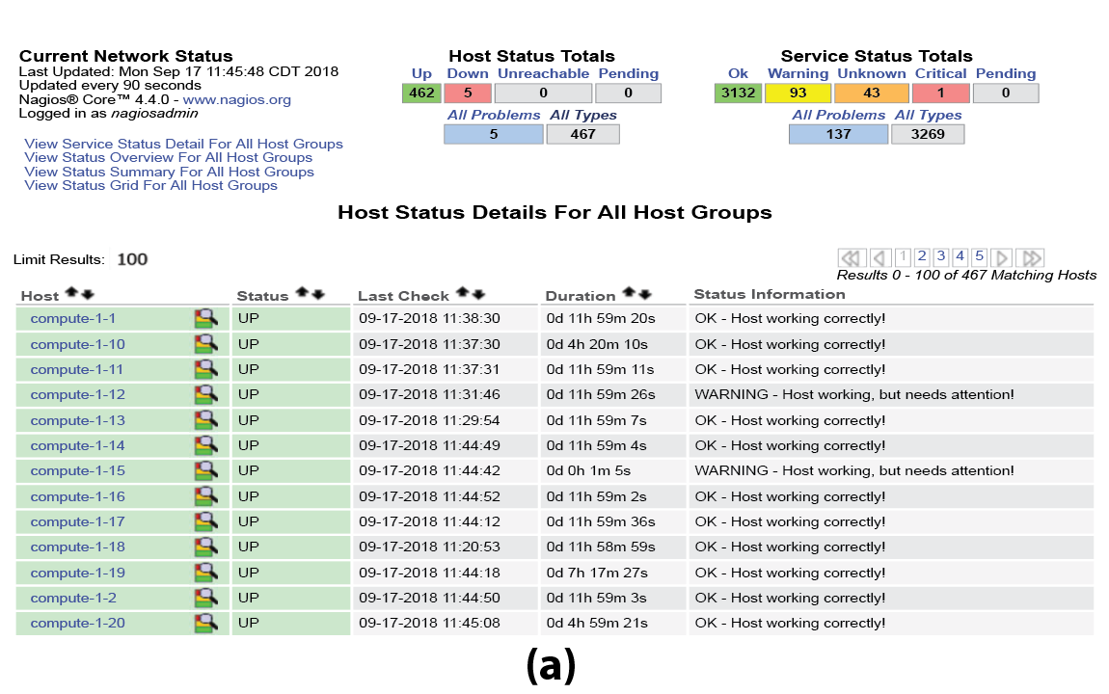
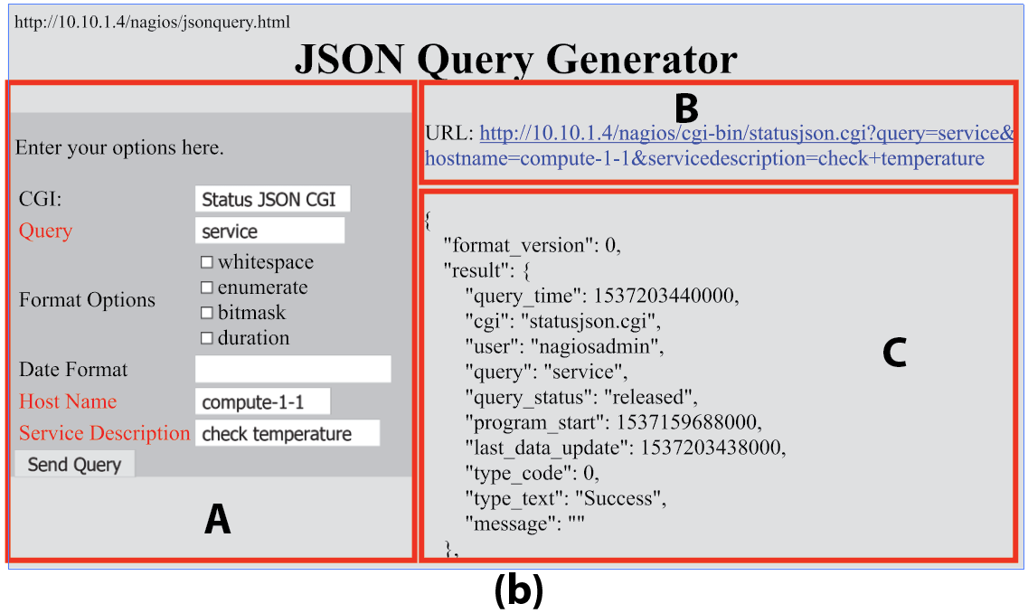
Existing approach and problem statement

Slide 10
Research Focus
We propose and develop an entire new interface to enable visual monitoring through the integration with Nagios and Redfish API

Slide 11
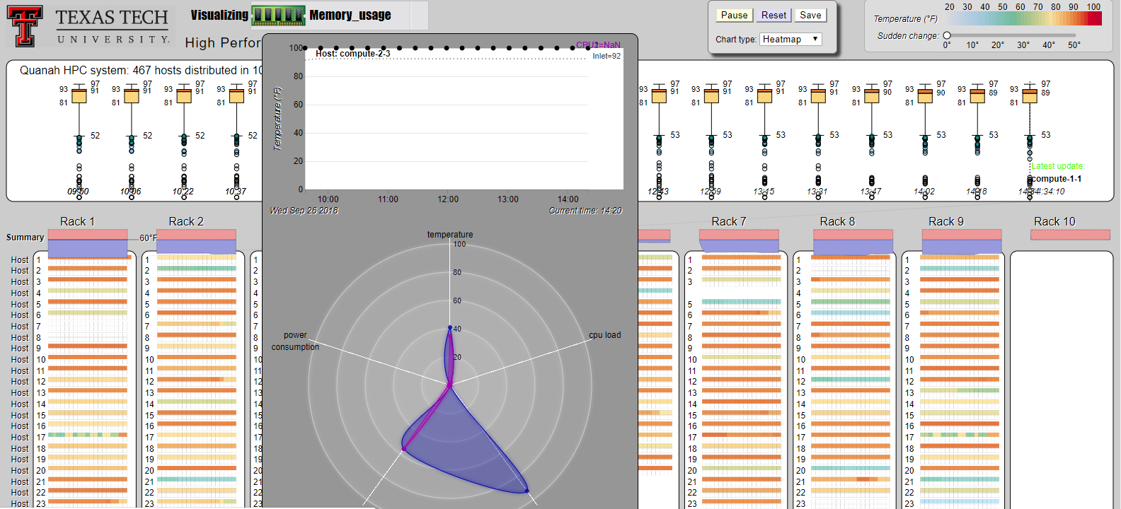
HPCViz architecture

Slide 12
Demo
Web interface 1:
https://idatavisualizationlab.github.io/HPCC/
Web interface 2: https://idatavisualizationlab.github.io/HPCC/vizOverheatSep26/index.html

Slide 13

Thank you for your attention

